Slide 1
Ticket Agency System
Team 5
Jixiao Yang 001444344
Xiaoge Zhang 001409334
Junyi Fang 001495265

Slide 2
1
PROJECT OBJECTIVE

Slide 3
Project Objective
Project Description:
A ticket agency system that allows a large number of users to buy tickets for at least three events concurrently, with numbers of tickets ranging from 1,000 to 100,000
Objective
The system can handle 1000 concurrent user requests in a short time and respond without error
Build the user interface that enable users to select events, purchase tickets and check their purchase histories; enable the ticket owner to check the event ticket details and ticket purchasing information

Slide 4
2
PROJECT
IMPLEMENTATION

Slide 5
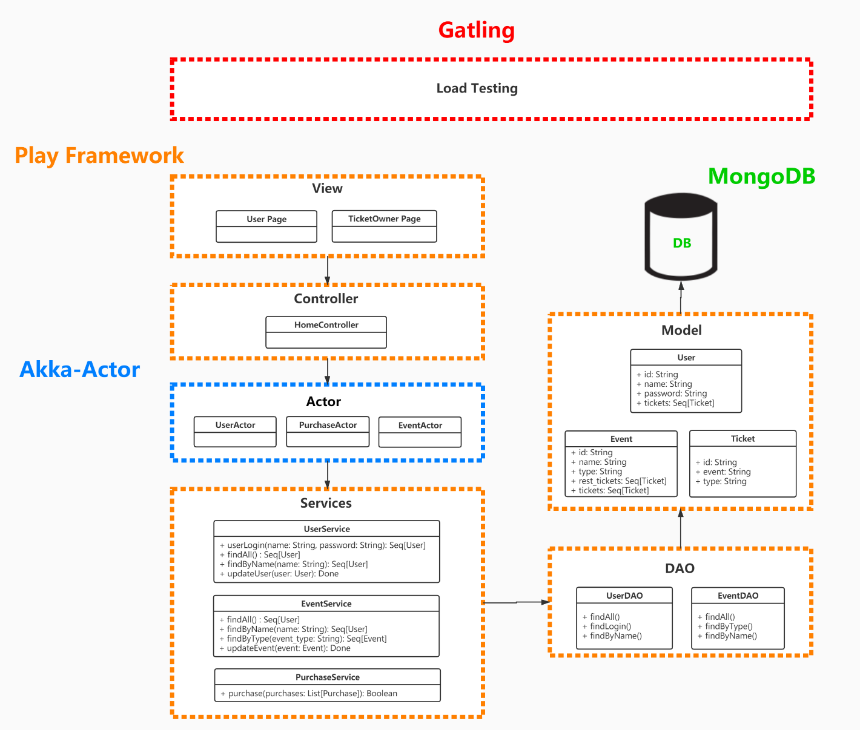

Slide 6
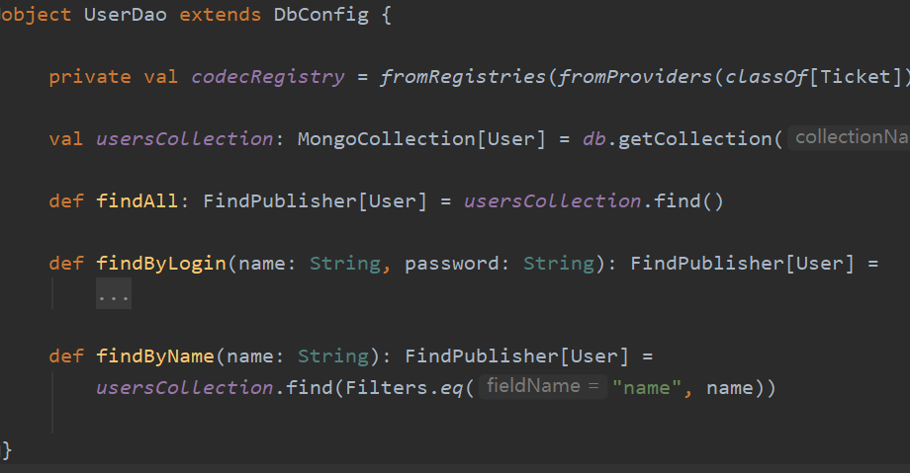
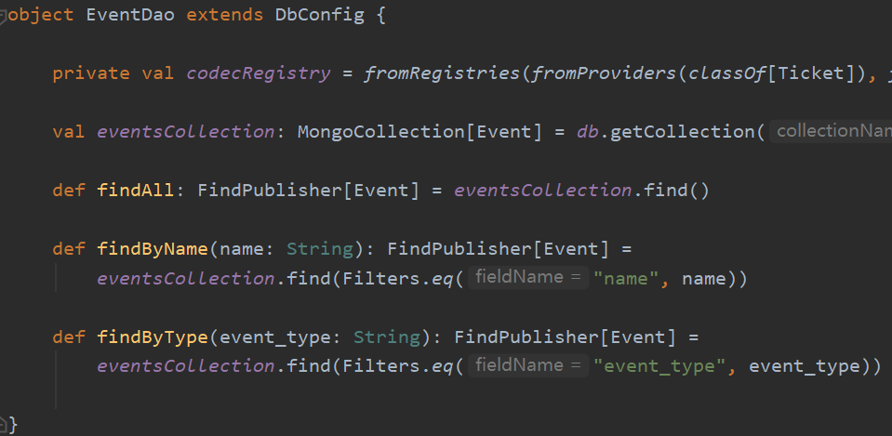
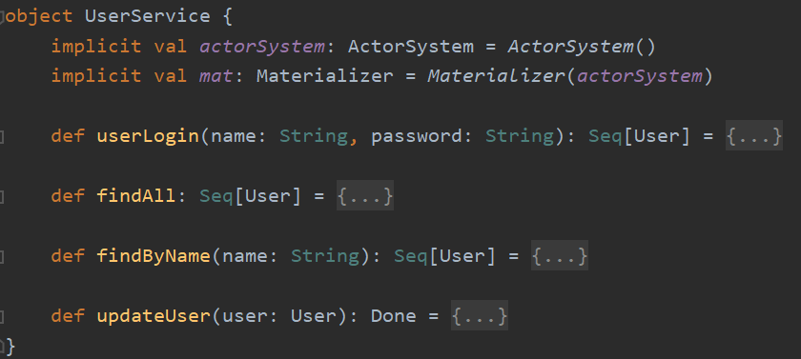
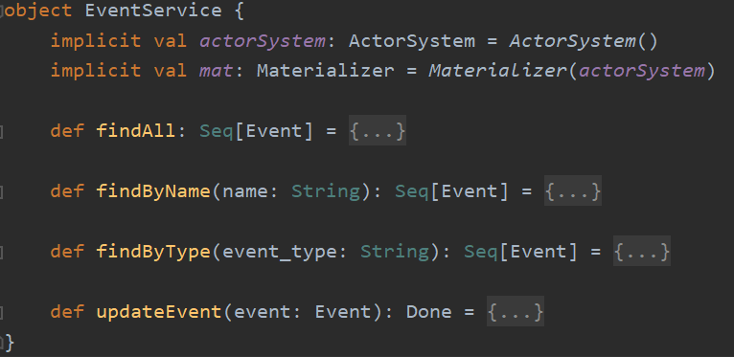
Project Implementation - Service
Call functions from DAO

Slide 7
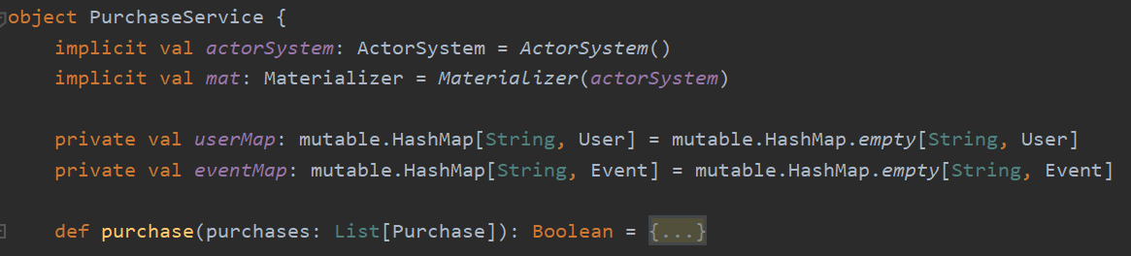
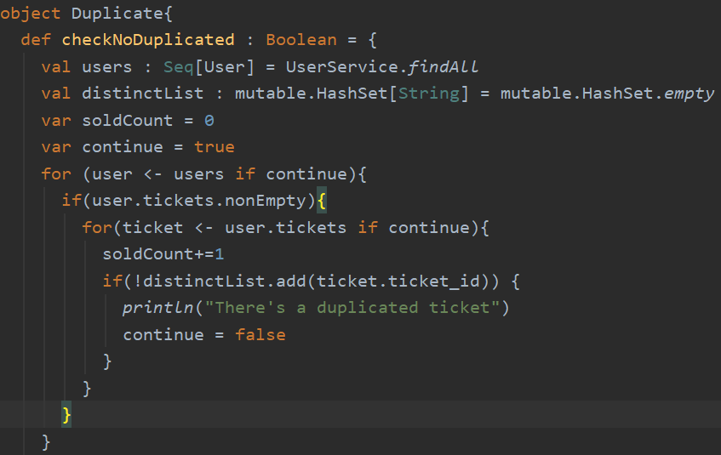
Project Implementation - Service
Check if multiple users get a same ticket

Slide 8
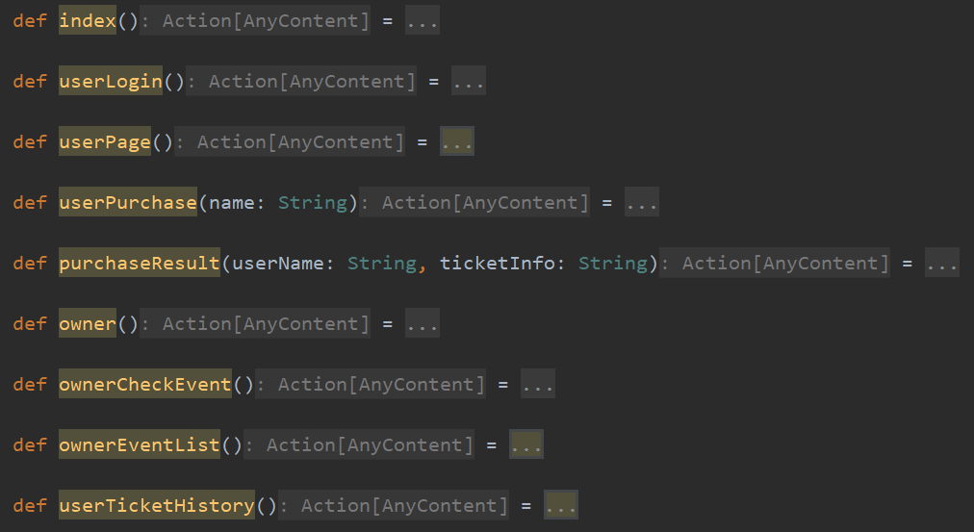
Project Implementation - Controller
Call by the view page as routes to switch between different pages

Slide 9
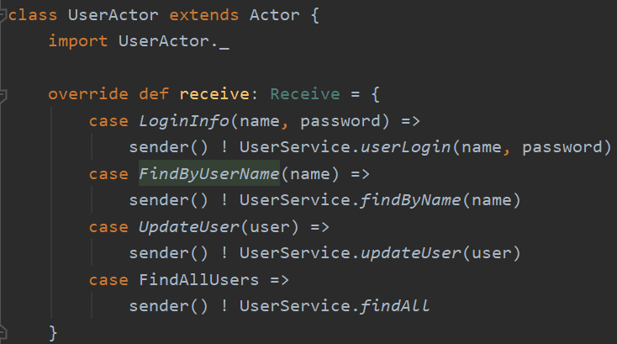

Project Implementation - Actor
Manipulate by the controller to concurrently complete actions defined in services

Slide 10
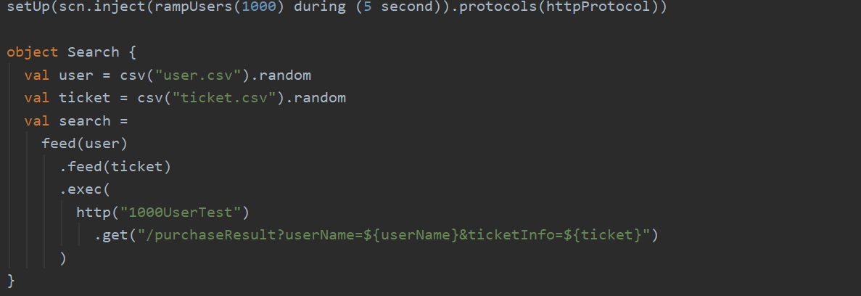
Project Implementation – Load Testing

Slide 11
3
USE CASE IMPLEMENTATION

Slide 12
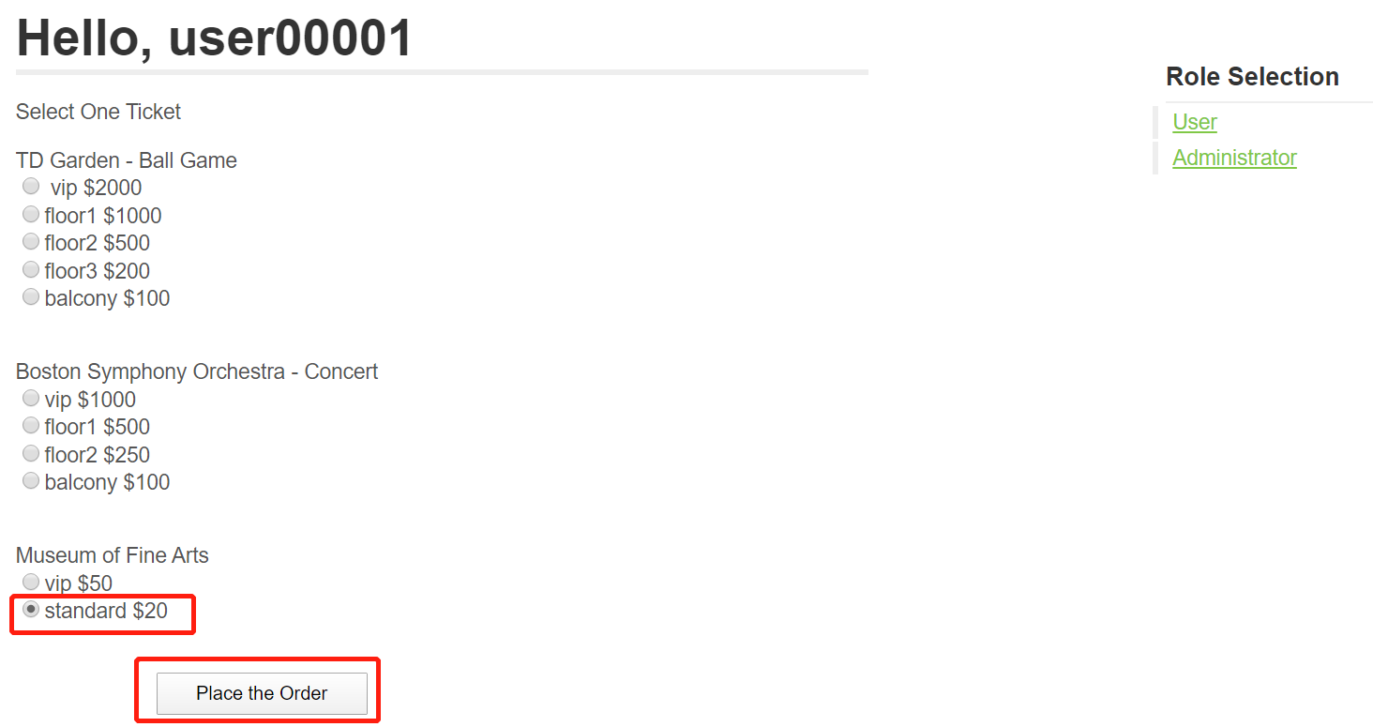
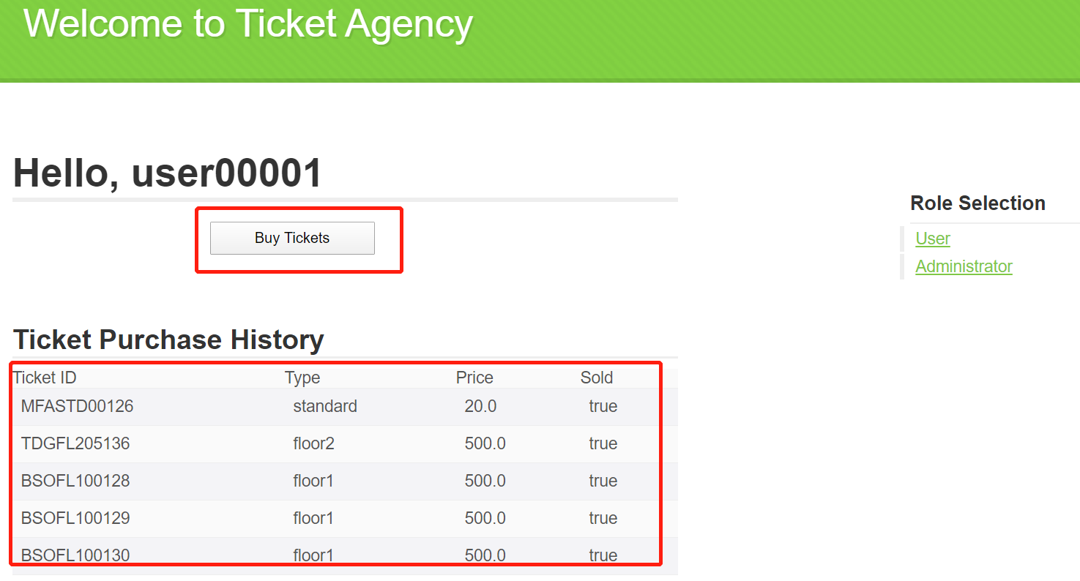
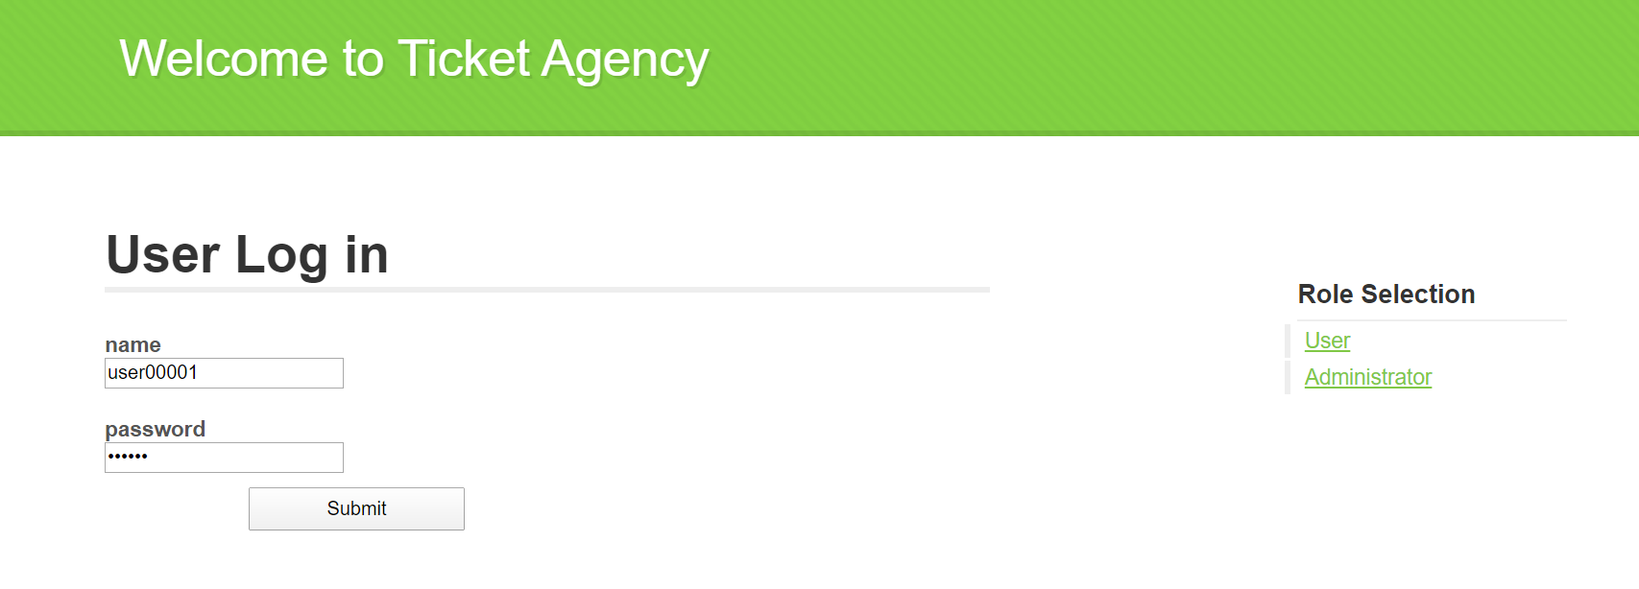
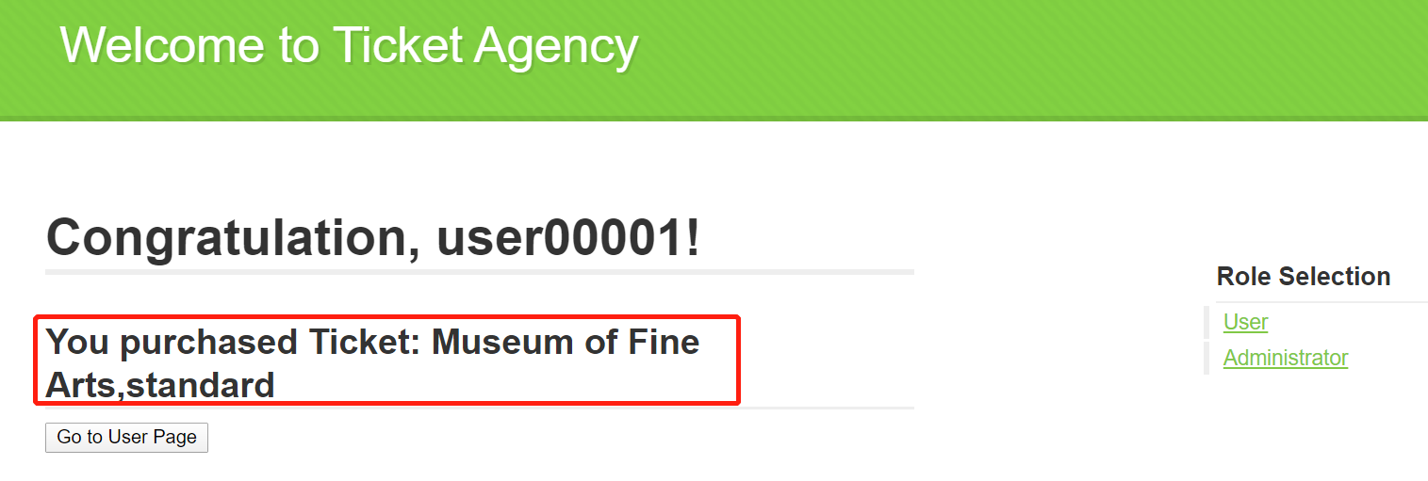
Use Case Implementation —— User
Action 1: Purchase tickets
Action 2: Check purchasing history
Notes:
The actor in our system will be the users who buy tickets from the ticket agency.
There are basically two actions for the actor. The first will be when a user selects an event (maybe a concert) and then purchase the ticket. And the System returns the ticket id to the user or message of ticket being sold out.
(Concurrent requests: System shows a list of results that which user gets what tickets)
The other action for the user wil be checking what tickets has he purchased and the user will receive the list of tickets the user purchased

Slide 13
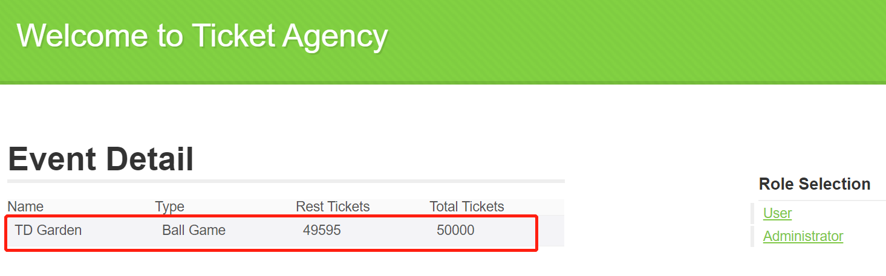
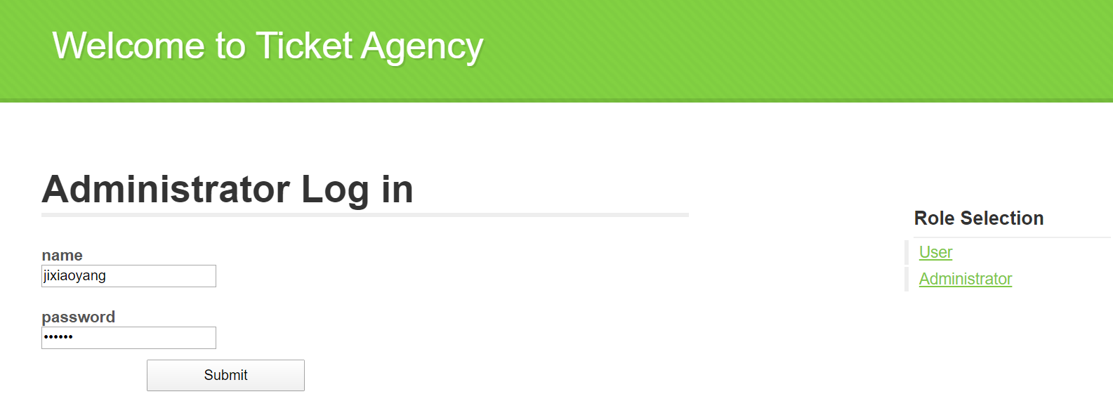
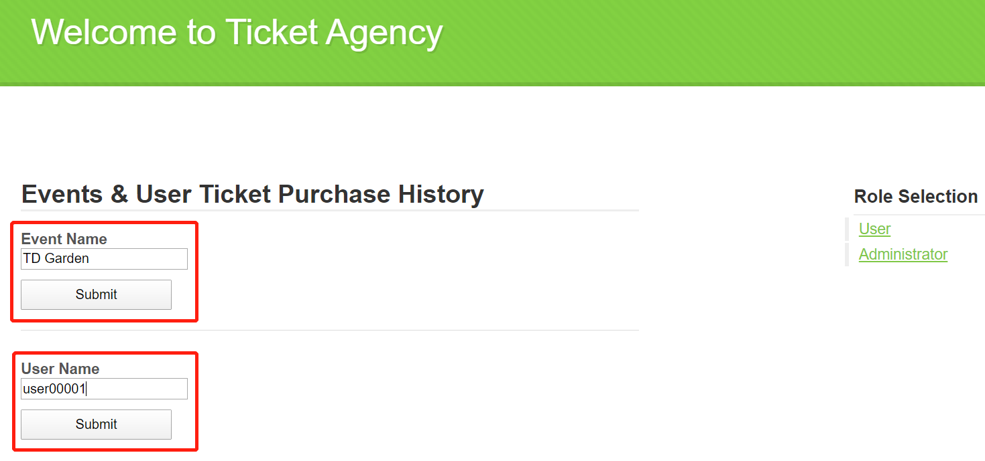
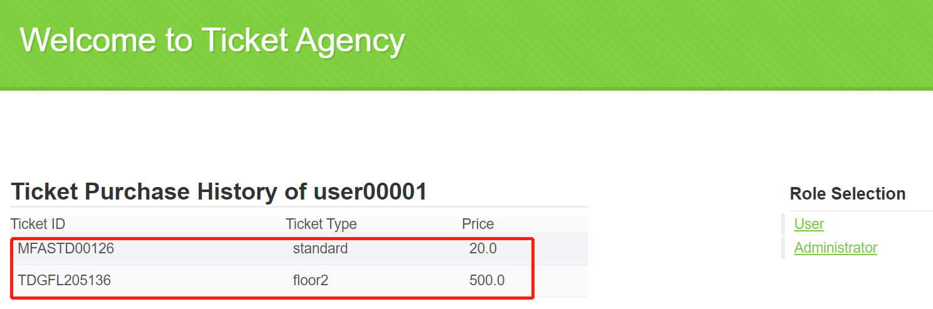
Use Case Implementation —— Owner
Action 1: Check event detail
Action 2: Check user purchase history
Notes:
The actor in our system will be the users who buy tickets from the ticket agency.
There are basically two actions for the actor. The first will be when a user selects an event (maybe a concert) and then purchase the ticket. And the System returns the ticket id to the user or message of ticket being sold out.
(Concurrent requests: System shows a list of results that which user gets what tickets)
The other action for the user wil be checking what tickets has he purchased and the user will receive the list of tickets the user purchased

Slide 14
4
TESTING

Slide 15
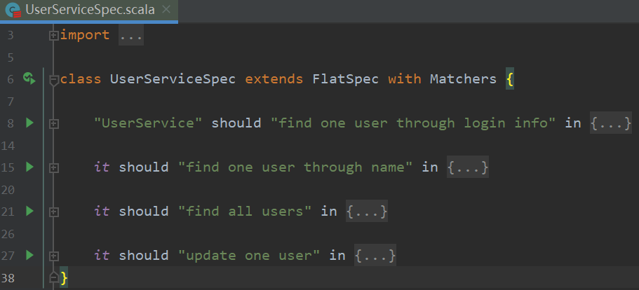
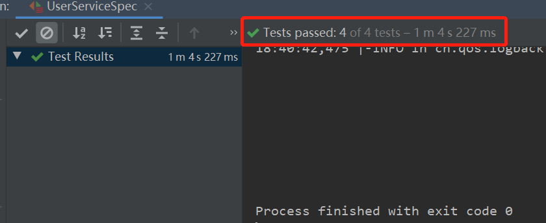
Unit Testing Results
UserServiceSpec: Unit test for all functions in UserService

Slide 16
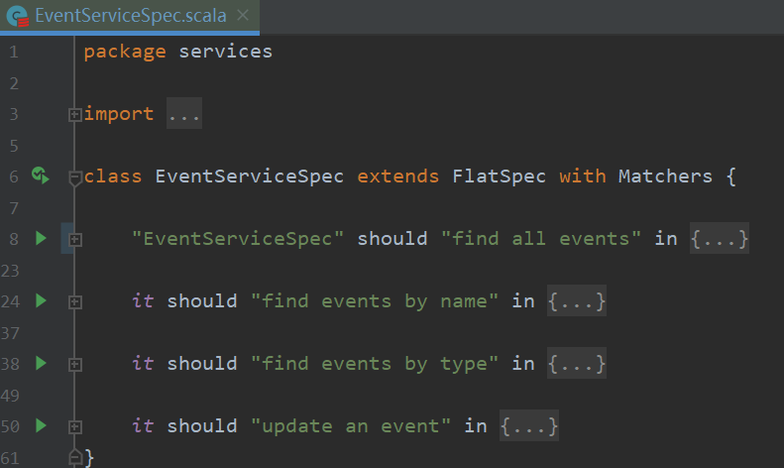
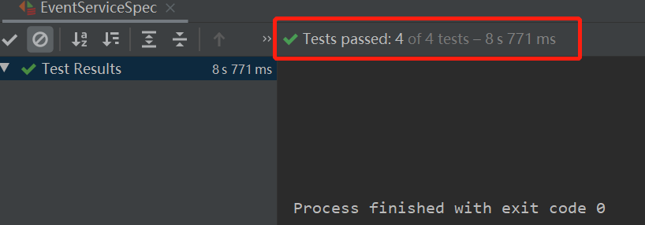
Unit Testing Results
EventServiceSpec: Unit test for all functions in EventService

Slide 17
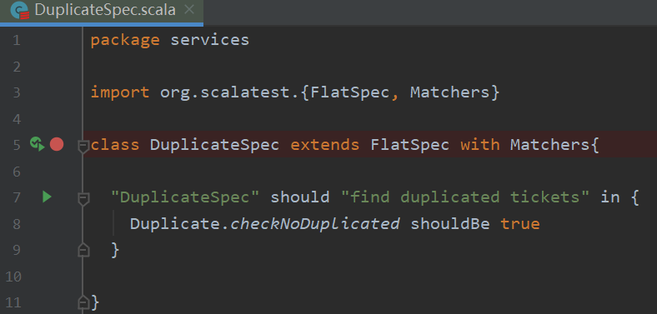
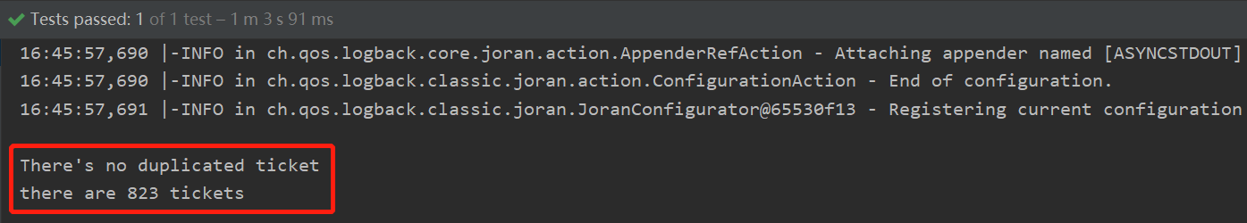
Unit Testing Results
DuplicateSpec: Unit test for checking duplicate ticket purchasing amoung all users

Slide 18
4
CRITERIA & RESULTS

Slide 19
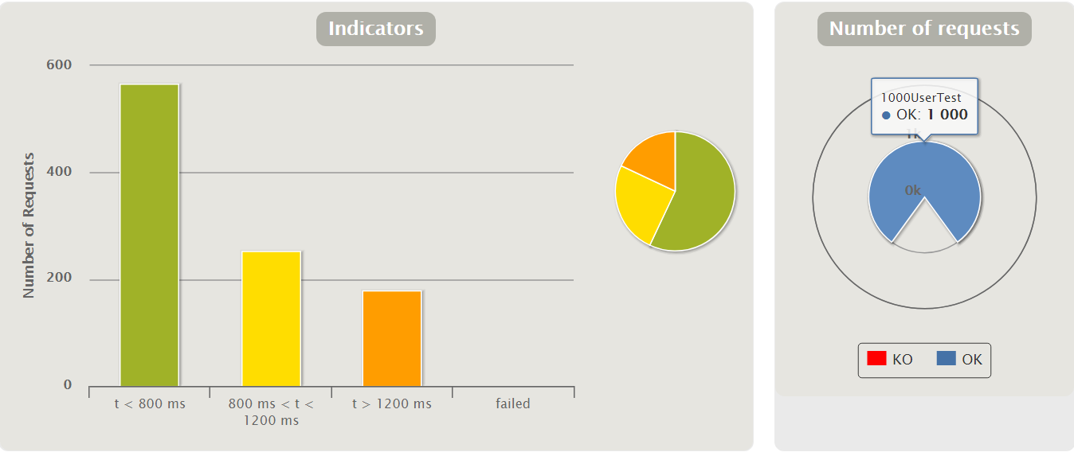
Criteria & Results
1,000 user: 100% request success rate
Criteria 1:
Allow 1,000 users to purchase tickets concurrently without any conflict (make sure every ticket can not be sold more than once)
One ticket sold for only once

Slide 20
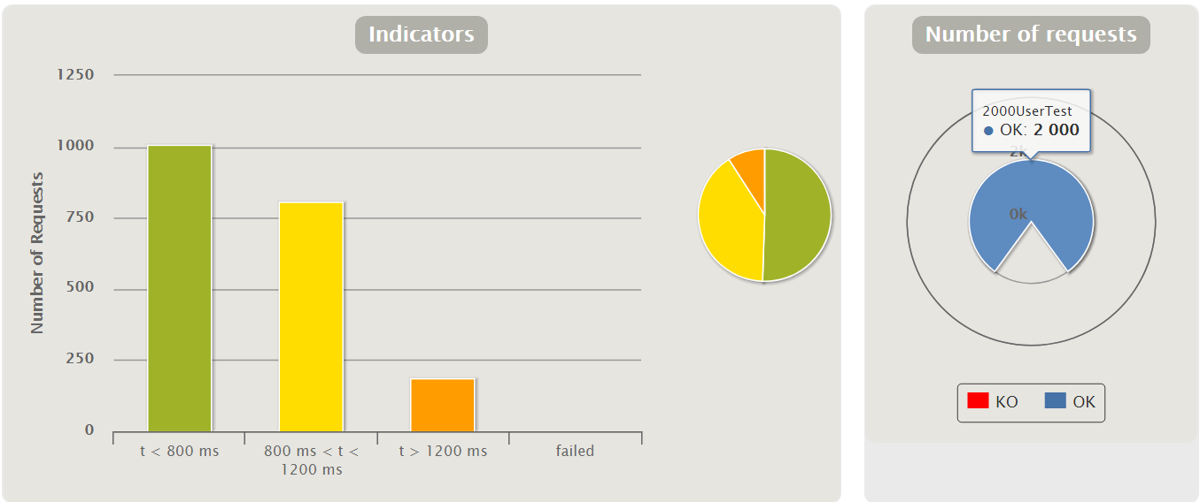
Criteria & Results
Criteria 1:
Allow 1,000 users to purchase tickets concurrently without any conflict (make sure every ticket can not be sold more than once)
2,000 user: 100% request success rate

Slide 21
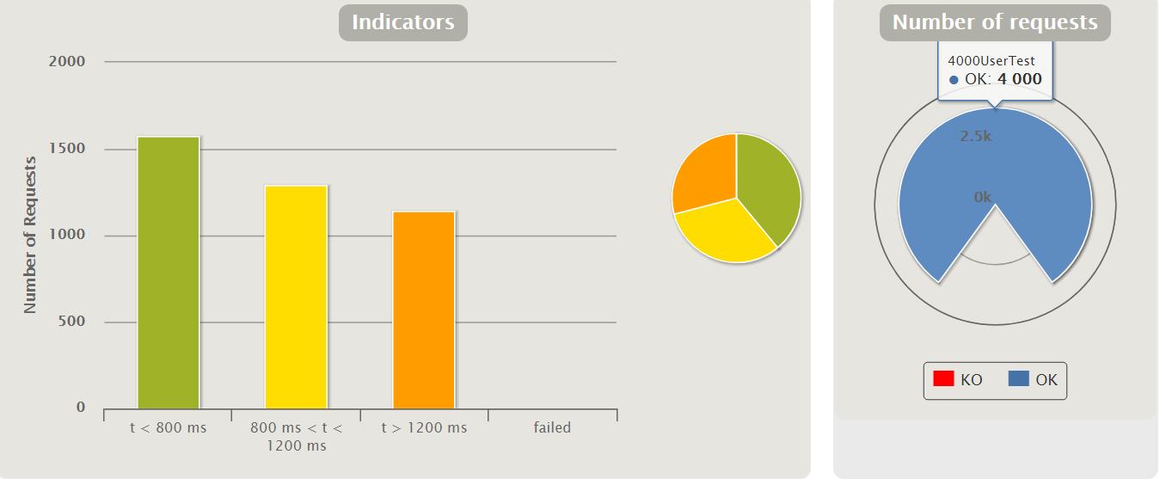
Criteria & Results
4,000 user: 100% request success rate
Criteria 1:
Allow 1,000 users to purchase tickets concurrently without any conflict (make sure every ticket can not be sold more than once)

Slide 22
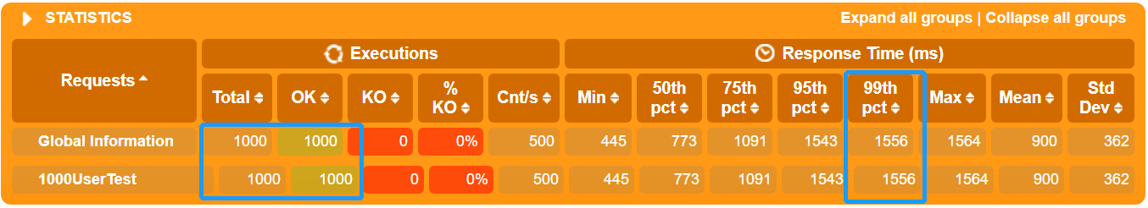
Criteria & Results
Criteria 2: Make sure 90% of user requests can be responded within 4 seconds
1000 users: 100%

Slide 23
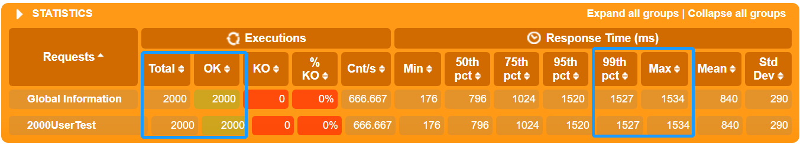
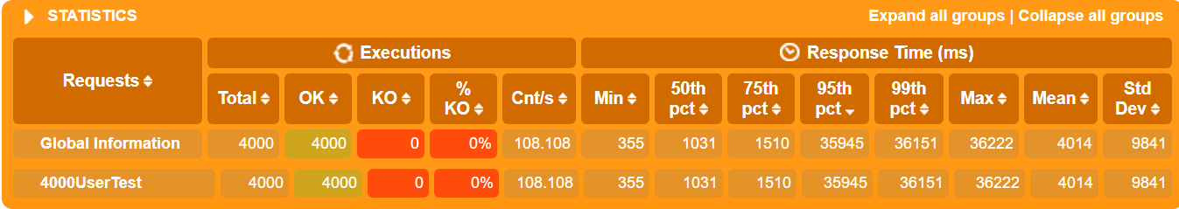
Criteria & Results
Criteria 2: Make sure 90% of user requests can be responded within 4 seconds
2000 users: 100%
4000 users: 91%

Slide 24
5
CONCLUSION

Slide 25
Conclusion
Neat User Interface for Users & Ticket Owners
Purchase tickets for different events
Check Ticket History
Check Event Detail
Concurrent Ticket Query & Purchase with No Conflict
100% success request rate for 1000 users to purchase tickets concurrently
A ticket can only be sold once
High Performance of User Query
1.5 seconds for 100% percent of 1,000 – 2,000 user queries
1.5 seconds for 91% percent of 4,000 user queries

Slide 26
6
DEMO

Slide 27
THANK YOU

